Slide 1

User Experience & UI development & SaaS Enablement
Oracle OpenWorld 2017 - Review

Slide 2
Enterprise User Experience
Enterprise IT users require a UX to perform the tasks they have responsibility for in way that is
Efficient, pleasant, with few errors/high quality
Regardless of where data and business logic resides – users should see and be able to interact with all data & operations relevant to their tasks
On a device and through a UX that fits their circumstances and needs
Users should be able to focus on what is most important
Smart systems interpret, predict, suggest, handle
Notes:
Objective when introducing a SaaS: providing business users with optimal UX to perform the tasks they have responsibility for (efficient, pleasant, few errors/high quality);
this means that regardless of where the data resides (in which SaaS app or custom app) they should see and be able to interact with all data relevant to their tasks

Slide 3
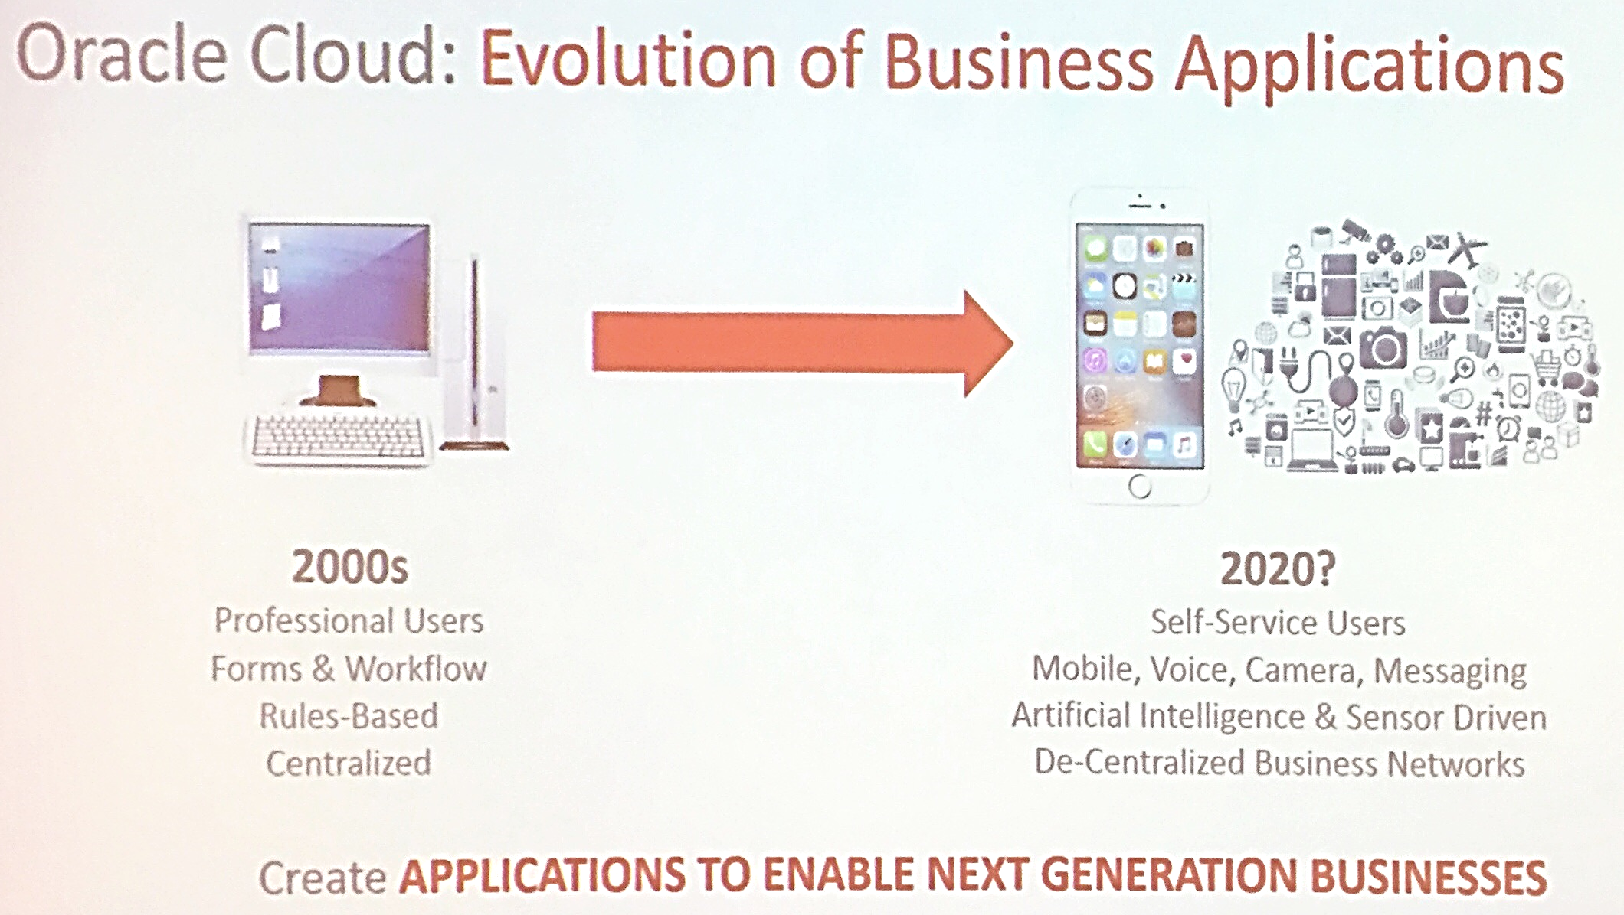
Oracle’s Vision on Business Applications

Slide 4
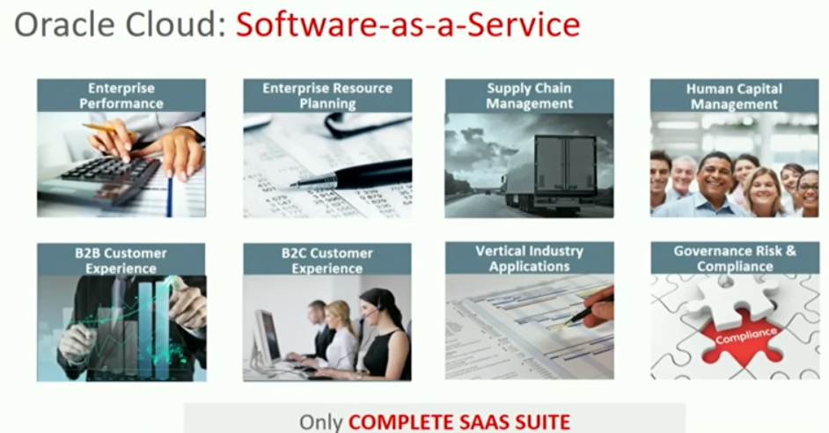
Ever expanding SaaS portfolio

Slide 5
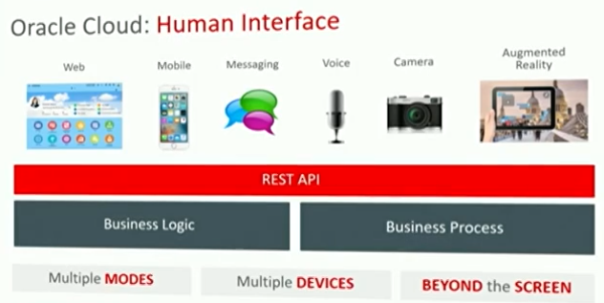

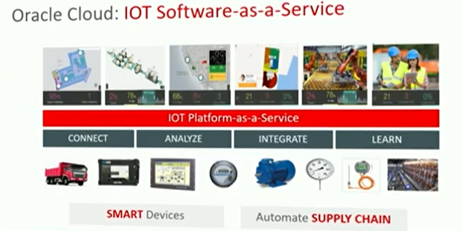
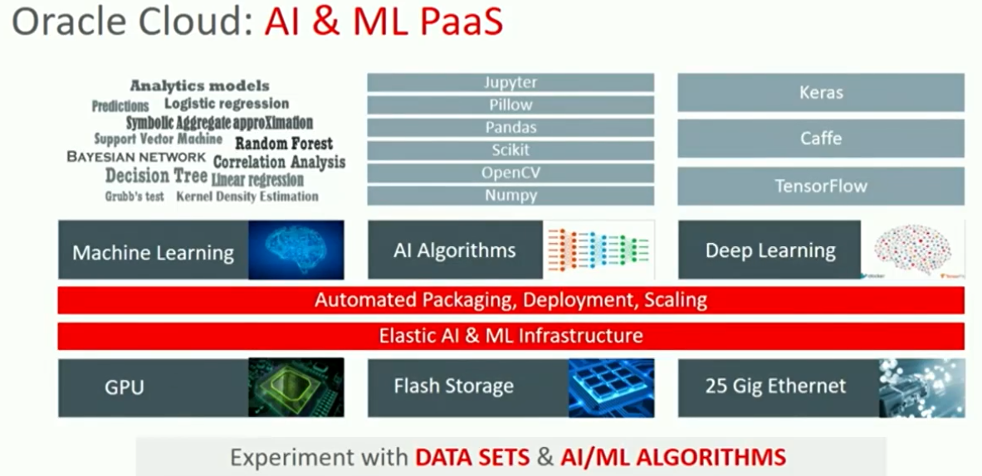
Smart, Multichannel Human-System Interfaces

Slide 6

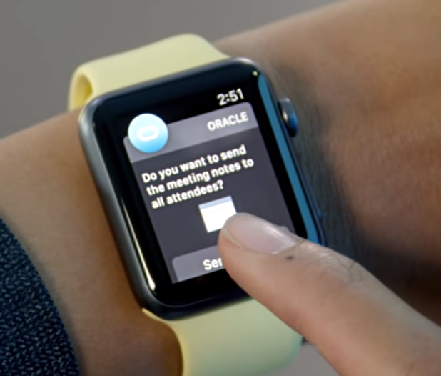
http://tinyurl.com/dayofux

Slide 7
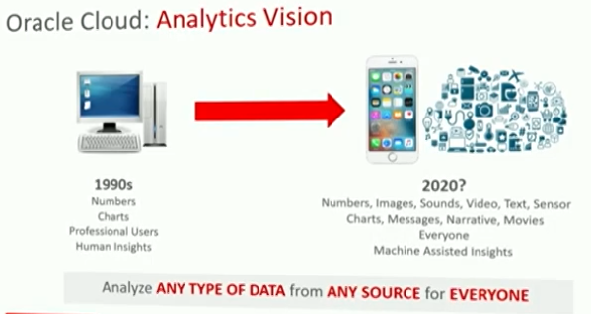
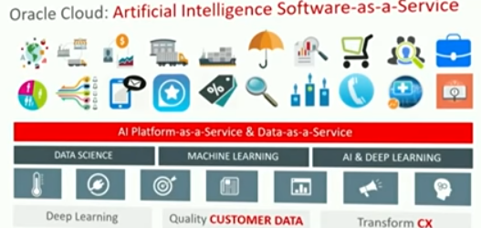
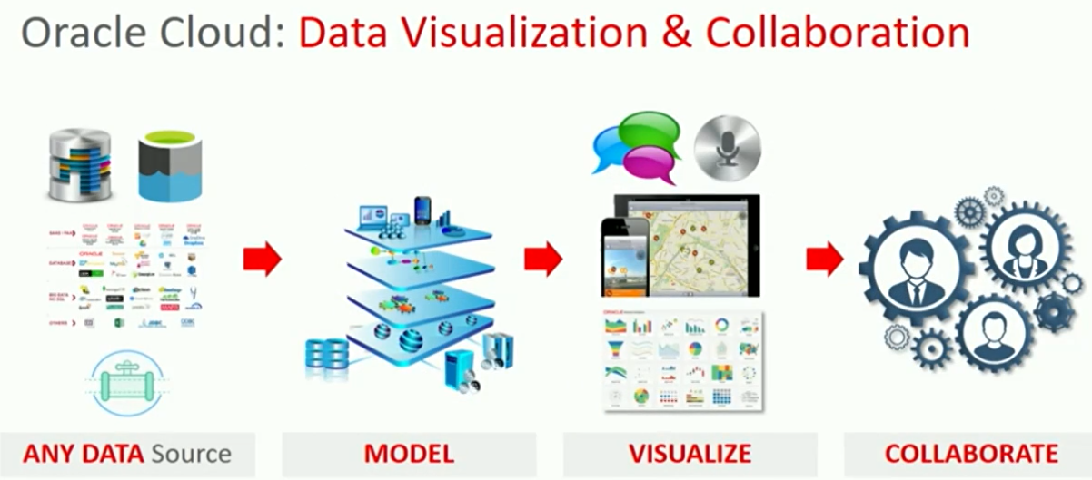
Analytics for Everyone

Slide 8
Common User Interface Requirements
Mobile App for service engineers
B2B Partner Portal
WebShop & Customer Service Web & ChatBot
3rd Parties/Public Internet
SaaS X
Dashboard / Analytical Explorations
SaaS Y
PaaS X
Workflow
Custom App B
UI for Planning Staff
On Premises
Custom App A
ERP

Slide 9
Approach with User Interface
Unlock data from SaaS & Custom applications
Using out of the box APIs
Using ICS (or SOA CS) with Cloud Adapters for SaaS
By creating direct custom access paths (usually not supported)
Design APIs for the UI developers to work against
Or agree with APIs already designed
Implement APIs
MCS, API CS, Node on ACCS/OCCS, “Oracle Functions”, SOA CS
Implement UI
Oracle JET on ACCS or on mobile device, MAX, Visual Builder CS, Data Visualization Cloud, Analytics, ADF on JCS, Intelligent Bots in Mobile Cloud, APEX on DBaaS
(optionally) Embed custom UI in one or more SaaS applications or in existing Enterprise Portal or external web site

Slide 10
UI Implementation with Oracle PaaS
Mobile App for service engineers
B2B Partner Portal
WebShop & Customer Service Web & ChatBot
Mobile
3rd Parties/Public Internet
Content & Experience
SaaS X
Intelligent Bots
MAX
JET on ACCS
API
SaaS Y
Analytics
PCS
PaaS X
Data Visualization
Workflow
Custom App B
APEX on DBaaS
Visual Builder
ADF on JCS
UI for Planning Staff
Conversations /Social Network
On Premises
Custom App A
Form, ADF, APEX, JET
ERP

Slide 11
Most striking
JET
JET 4.0 (New custom element syntax, CDN, CLI, improved UI components)
Upcoming RDK from OAUX team
Visual Builder Cloud
MAX
Offline
Mobile Cloud
Intelligent Bots
RDK from OAUX team for Conversational UI
ADF
APEX
Forms
SQLcl (& SQL Developer)
Notes:
http://www.oracle.com/webfolder/ux/applications/successStories/oracleApplicationsCloudRDK.html
Conversational UI RDK: https://apex.oracle.com/pls/apex/f?p=119076:1:0:::::

Slide 12
News for Database Developers
SQL Developer (17.3, from now on quarterly releases)
Browser based
New features: Sharding, formatter, database search
AWS RedShift Migration support
SQLcl (in line editing, 3rd party database,..)
ORDS
REST SQL, REST for OPS, REST Driver, Swagger Support
Oracle Database 18c XE – (almost) all options incl 4 PDBs
12 GB storage (and compression), 2 GB SGA, 2 CPU
Database Free Cloud Service (1 GB storage)
Polyglot Database (powered by Graal VM)
Expose JavaScript NPM modules as PL/SQL functions (Download: http://www.oracle.com/technetwork/database/multilingual-engine/overview/index.html)
Notes:
http://www.oracle.com/technetwork/database/multilingual-engine/overview/index.html

